Slide 1

G-DUMP
CLEAN INDIA,STRONG INDIA

Slide 2



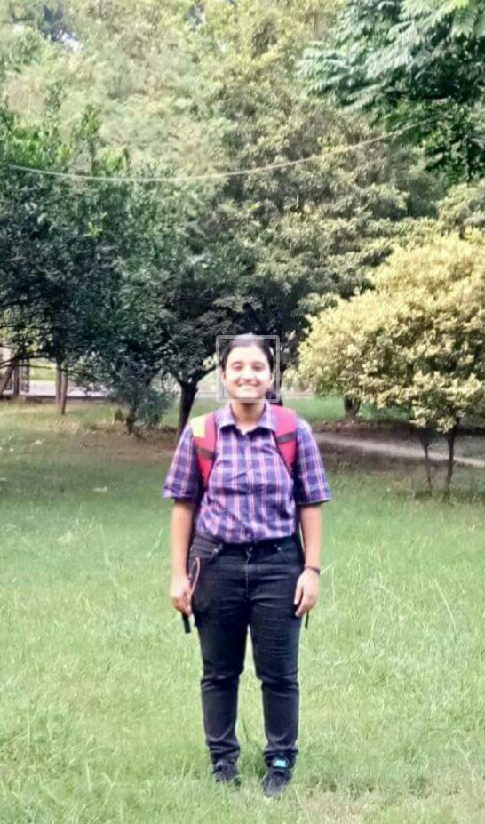
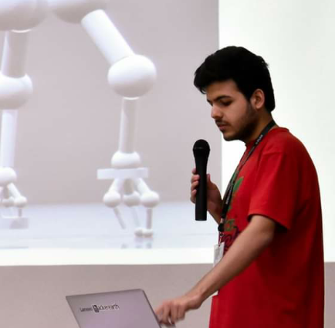
Abhishek Sharma Founder, Leader of the venture.
Keshari Nath Tiwari : App developer, designer, founding member
Bhuvan Jhamb : Data analyst, marketing manager, founding member
Pragati Awasthi:
Team member
Archit Chaudhary : Spokesperson, designer, founding member
Amisha Agarwal : Circuit & bin designer, founding member

Slide 3
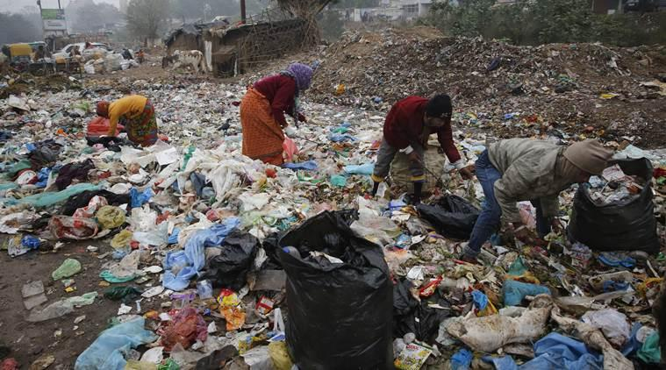
Indian waste management:

Slide 4
WASTE MANAGEMENT
PRESENT SCENARIO:
No Segregation of waste
Lack of scientific approach
Non-Involvement of common masses
Under-utilisation of resources
Result: Completely inefficient model leading to huge waste of manpower and money.

Slide 5

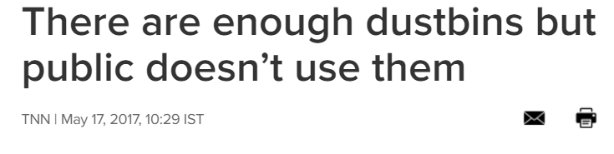
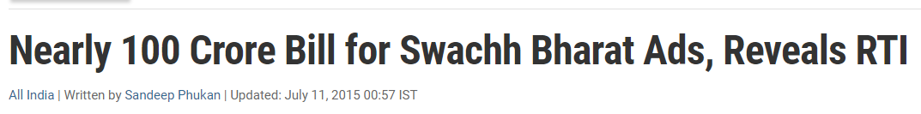
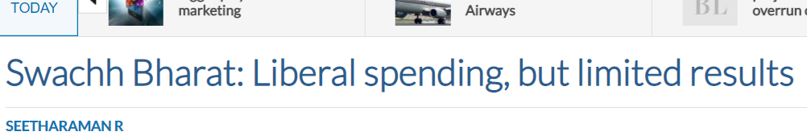

Slide 6
INDORE MODEL
SUCCESS
FAILURE
GEELA N SUKHA
CLEANEST CITY
DOOR TO DOOR
PUBLIC SUPPORT
WORKFORCE

Slide 7
Loopholes of indore model:
Huge Manpower needed (nearly 3200 rag pickers + other staff members in the city)
Over 400 vehicles are needed to carry out day-to-day work.
Huge investment on the government’s part.
Works mainly on public awareness and fines.
High collection and transportation cost Rs. 2886 per MegaTon
Such an active administration is a rarity among municipal committee/corporation in the country.

Slide 8
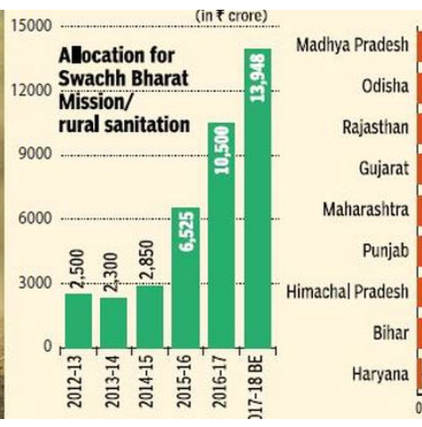
Swachh Bharat:
The not so successful model
In October 2014, the current Prime Minister of India, Narendra Modi, launched a massive campaign called Swachh Bharat (‘Clean India’)
13,948 Crores allocated for 2017-18
33,283 Crores allocated till now
Still no revolutionary change visible at ground level
In October 2015, the Swachh Bharat campaign celebrated its one-year anniversary and it became clear that the situation with garbage on the streets had not changed(Brics business Magazine)

Slide 9

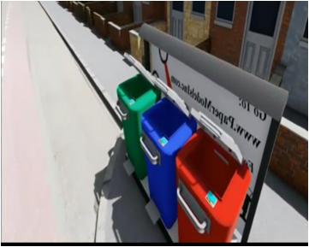
Our solution: G Dump
•A User centric process
•Curb side arrangement of bins
•Segregation at root level
•Connects user and waste management
•Tempts user to use our facility by proper awards
(can be around Rs.100 per family per day)
•Connects the missing links in existing system
thus leading to effective waste management.

Slide 10
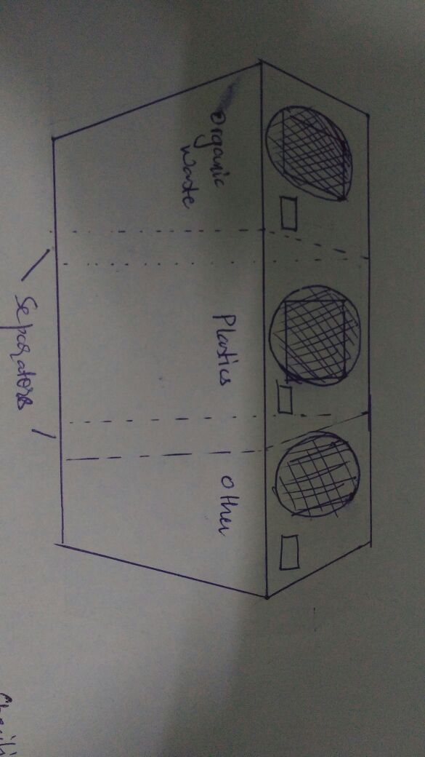
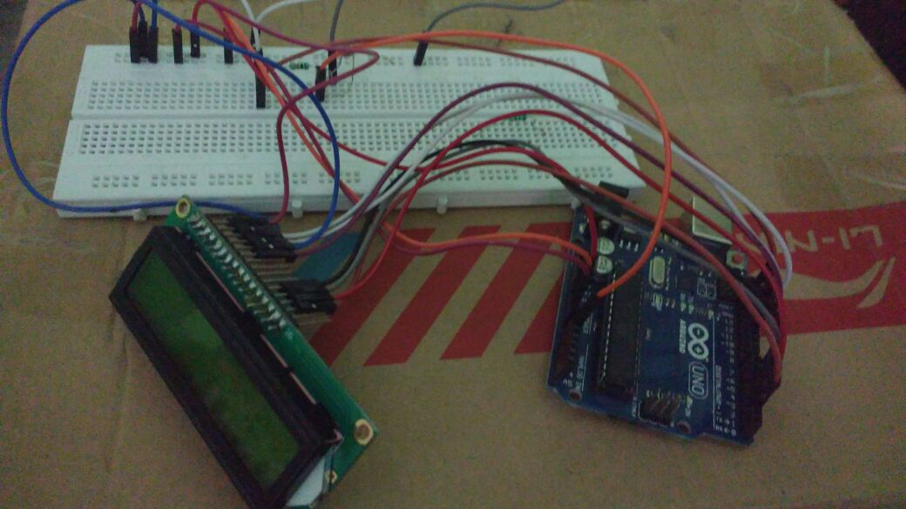
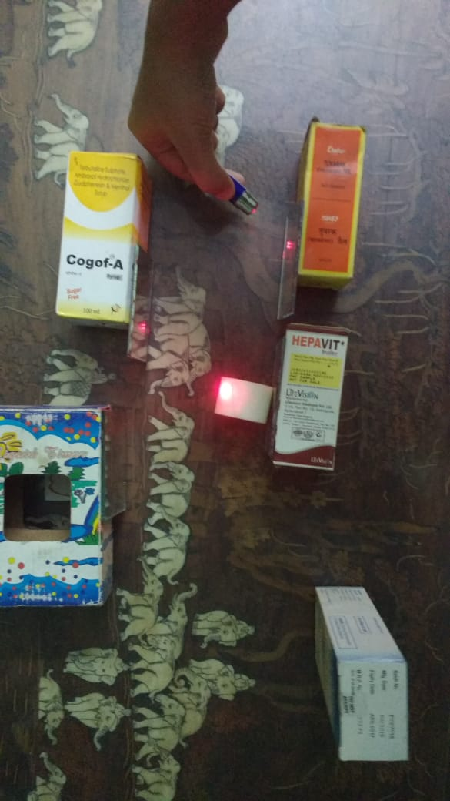
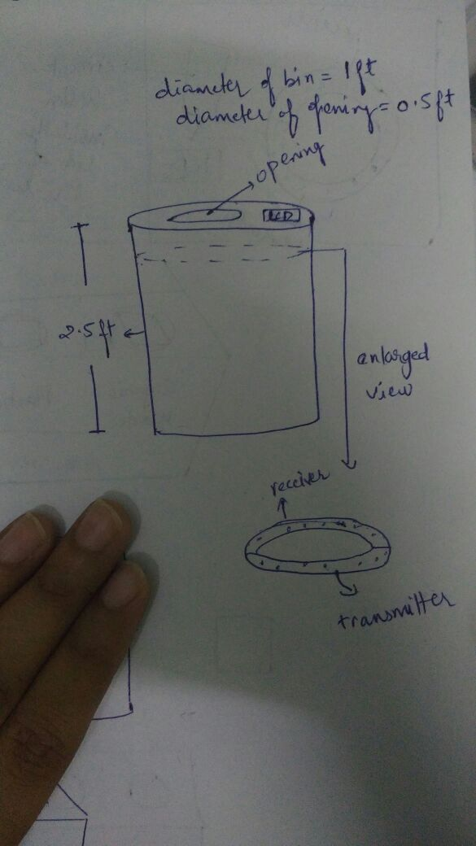
Early experimentations
EARL
eA

Slide 12
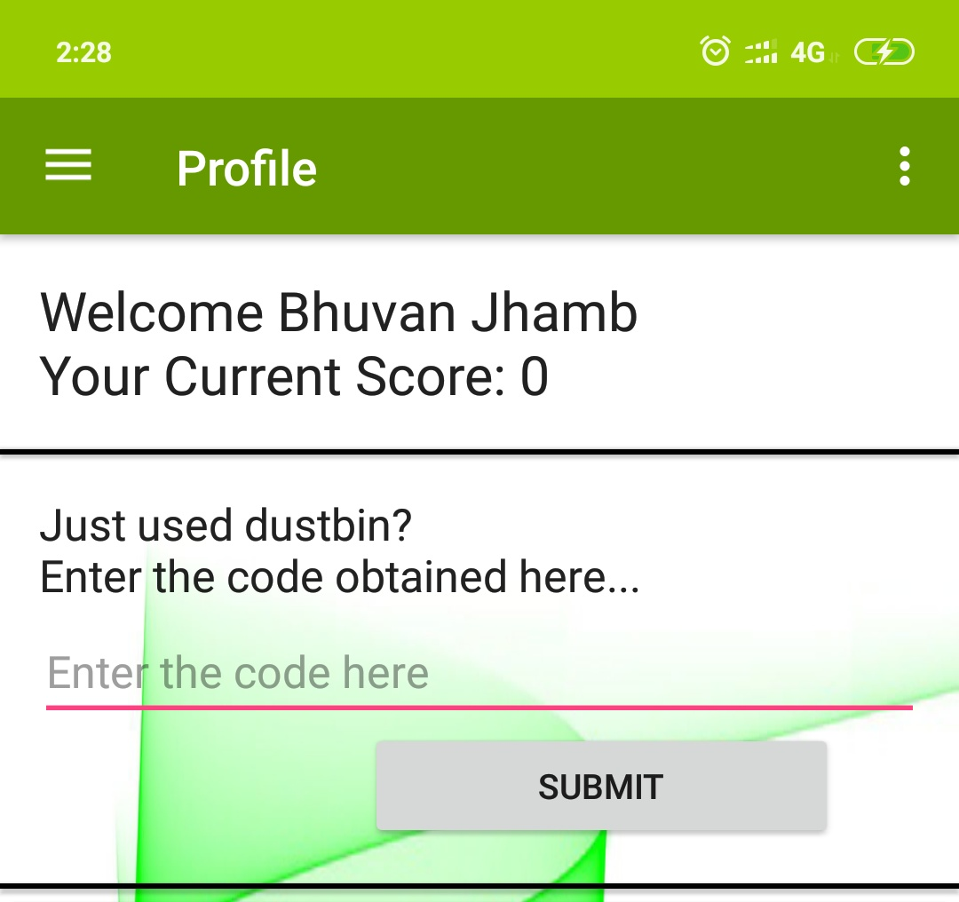
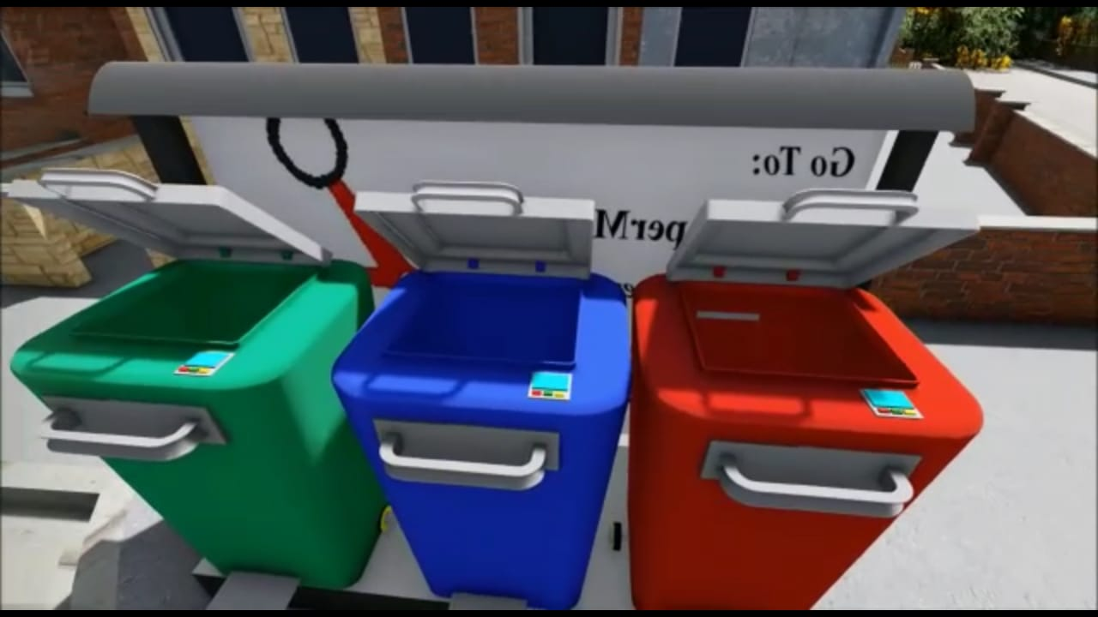
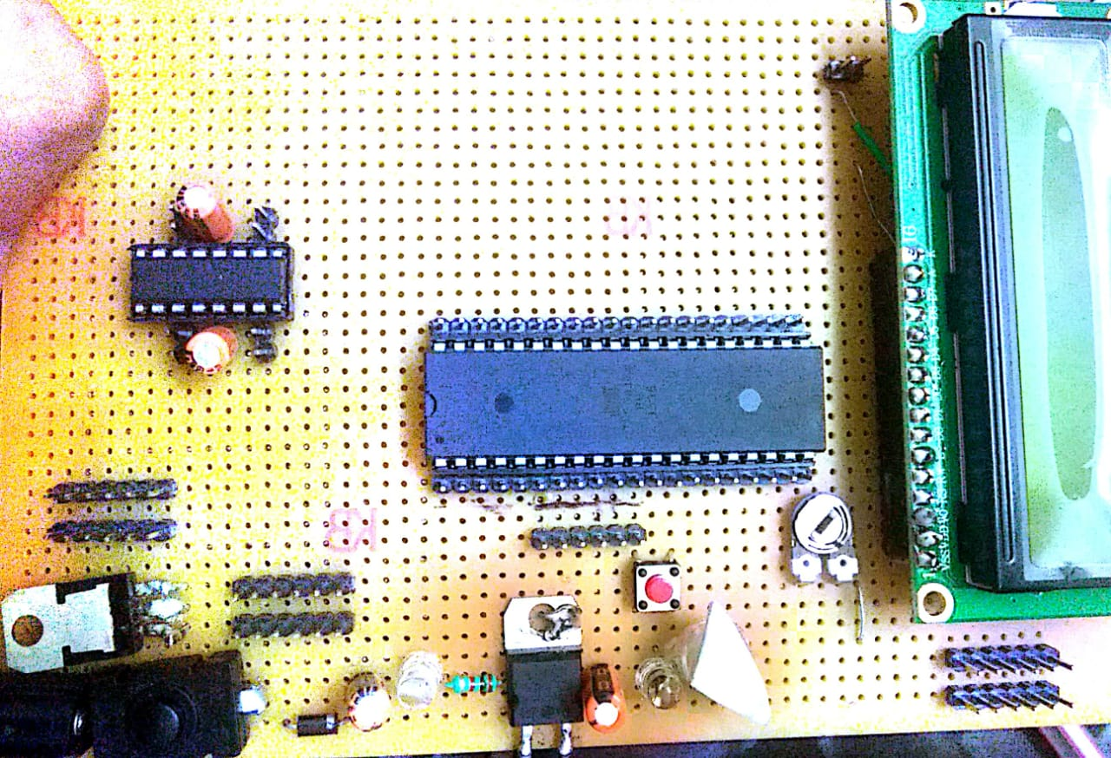
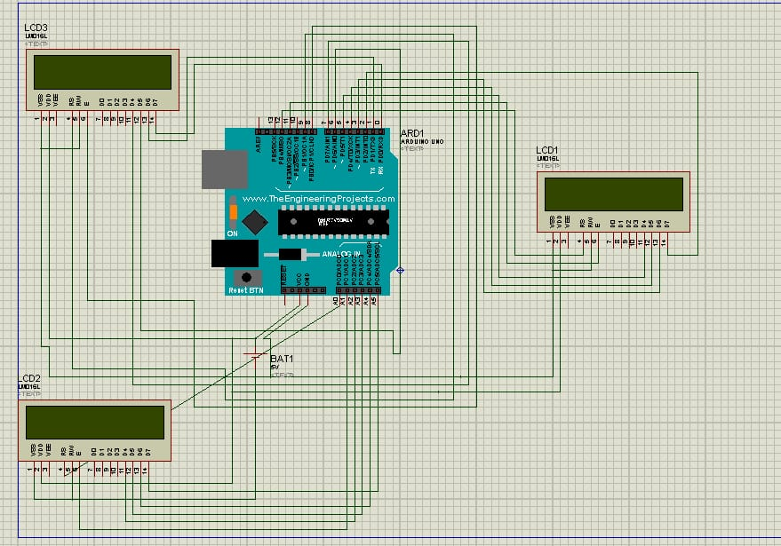
Final Designs
Bin Design
G-Dump App
Part of G-Dump Circuit
Simulations

Slide 13
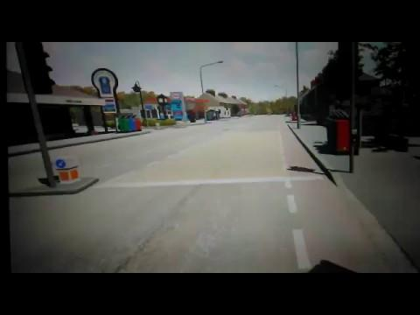
G-DUMP
CLEAN INDIA,STRONG INDIA

Slide 14
G-Dump. UNIQUENESS
ROOT LEVEL SEGREGATION
UNIQUE TECHNOLOGY
REWARDS
AND INCENTIVES

Slide 15
G-Dump
Step 1 :
A person throws waste into the dustbin.
GENERATION OF CODE
Step 2 :
G-Dump database has all codes listed with rewards
Rewarded For using our bins
Step 3 :
The app shows ads of sponsors
GENERATION FROM WASTE
GOLD FROM GARBAGE

Slide 16
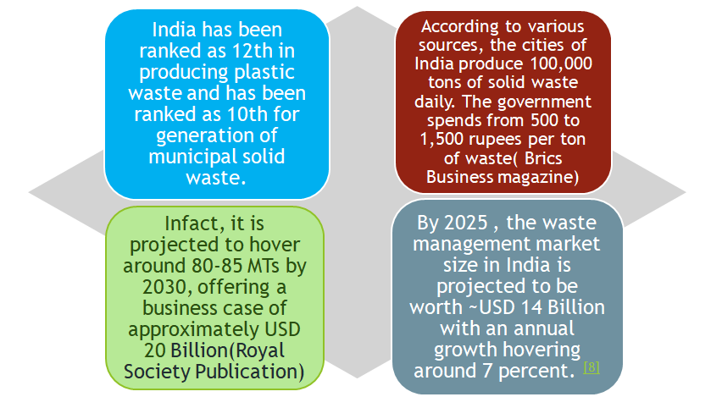
MARKET OPPORTUNITY

Slide 17
MARKET PENETRATION’
STAGE 1) TIE UP WITH SOME INDORE LIKE MODEL
What we will offer:
efficient segregated garbage collection at very low cost which can be used as raw material for their processing plants. Thus saving their huge capital and manpower requirements.
What we need:
Initial administrative support
Their plants and setups for treatment of waste collected by our bins.
Support for popularising our model
Stage 2) Later expansion to places where processing plants exist.
Stage 3) Expanding to other places

Slide 18
Domestic Revenue Model: How can we promise to pay and earn as well???
Consider a 1000 family town :
Total waste generation:1000*2=2000 kg
Segregation comes into play:
1) Wet Waste-50% (46%)
2) Dry Waste-50% (44%)
1) Wet Waste:
46% of total
For 1 tonne approx.
150-180 CUM
75% of methane
(120 CUM)
Cost=120*2000=2.4 lakhs.
+manure generation worth 2000.
2) Dry waste:
44% of total
For 1 tonne approx.
Majorly plastic : soft(70%) and
hard(30%) Includes e-waste, rubber
and other things.
Expected Revenue:15000 per day.
Total Revenue:2.4 Lakhs
Total Revenue:15000 Rs

Slide 19
OUR REQUIREMENTS:
Maintenance Requirements
30-35% Transport and segregation
+labor cost
30 percent(75000 Rs) distribution to users daily
Total 65 percent of revenue
INITIAL FUNDING 1 dustbin per 5 families
200 dustbins required
High ball cost:
200*1000=200000

Slide 20

App income sources
.Adsense And Selling Data to Advertising Firms
Adsense To be used only after sucessful market Penetration
Depending on number of users income varies from 0 .8 to 1.2 Dollars
per thousand users(Indian Data)
Indore’s population is around 28 lakhs with 15 lakhs active users,
thus giving us a large potential market
Success of models like LOCO which are giving as much as 2.5 lakhs per game ensures our success.

Slide 21
2.5 lakhs per 1000 Families/Day
+ But Major Source still remains.
Advertisement:
>Connecting companies
Through CSR
>Displaying their banners and ads

Slide 22
A Presentation From Team G-Dump
Your Queries Are Welcome
THANK YOU

